Slide 1
Course Overview:
Software Quality,
Verification and Validation
CSE 4495 - Lecture 1 - 15/10/2022
Instructor : Md. Mohaiminul Islam

Slide 2
Today’s Goals
Introduce The Class
What is this course about
Go over Course Outline
What you should already know
Clarify course expectations
Assignments/grading
Answer any questions
Cover the basics of verification and validation

Slide 3
When is software ready for release?

Slide 4
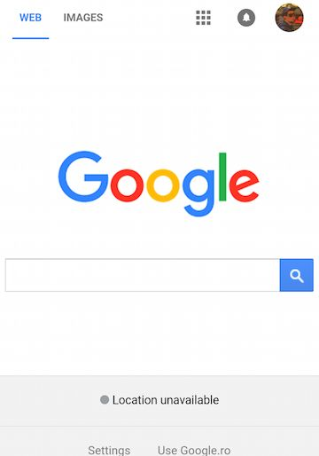
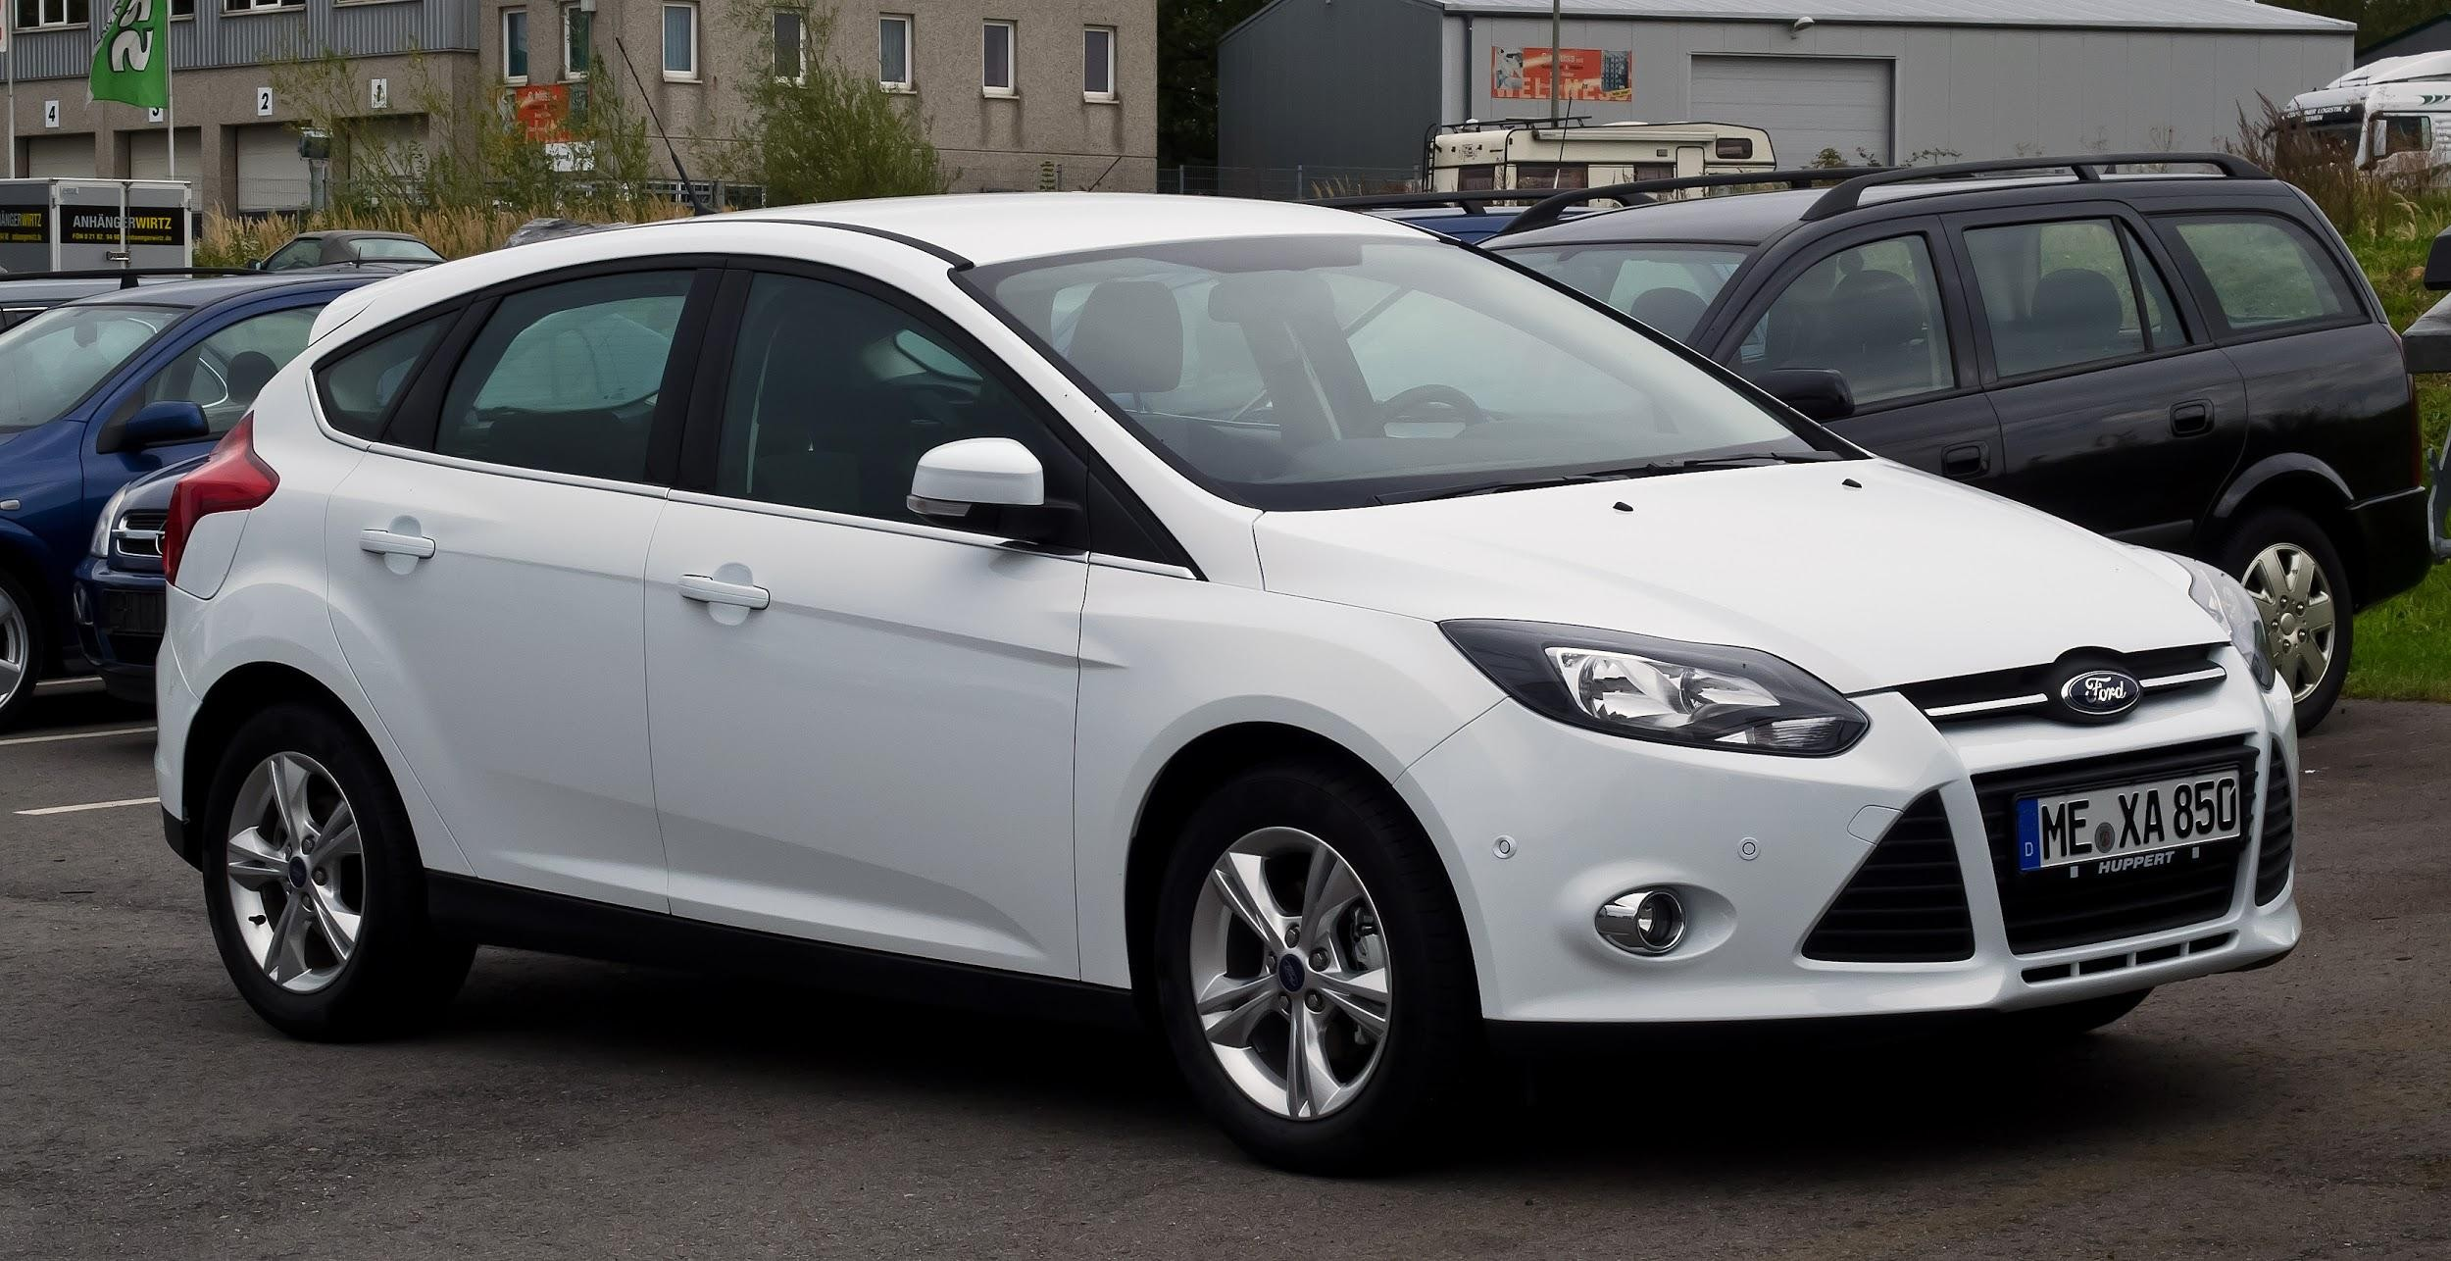

Our Society Depends on Software
This is software: So is this:
Also, this:

Slide 5
Flawed Software Will Hurt Profits
“Bugs cost the U.S. economy $60 billion annually… and testing would relieve one-third of the cost.”
- NIST
“Finding and ﬁxing a software problem after delivery is often 100 times more expensive than ﬁnding and ﬁxing it before.”
- Barry Boehm (TRW Emeritus Professor, USC)

Slide 6
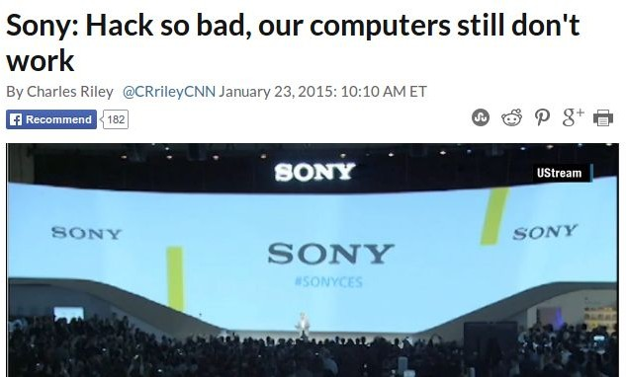
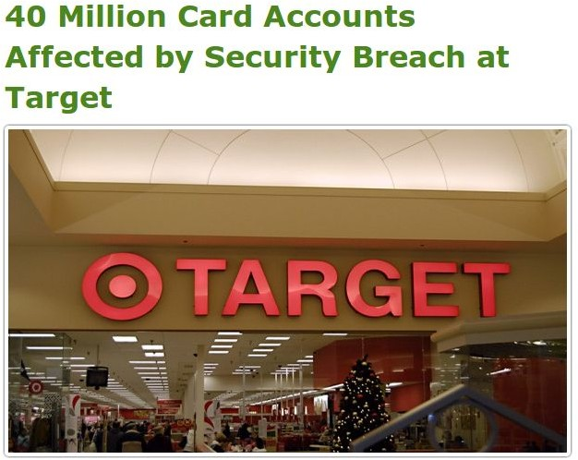
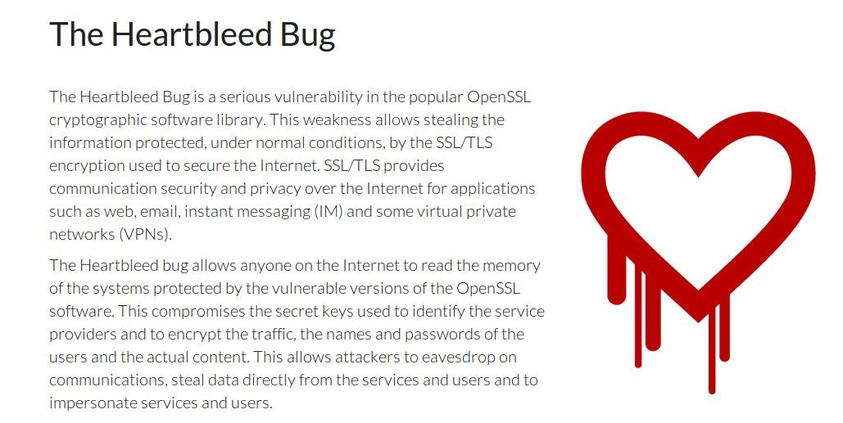
Flawed Software Will Be Exploited

Slide 7
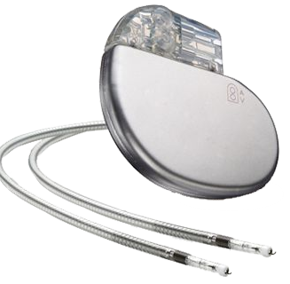
Flawed Software Will Hurt People
In 2010, software problems were responsible for 26% of medical device recalls.
“There is a reasonable probability that use of these products will cause serious adverse health consequences or death.”
- US Food and Drug Administration

Slide 8
This Course
What is “good” software?
Determined through quality metrics (dependability, performance, scalability, availability, security, ...)
The key to good software?
Verification and Validation
We will explore testing and analysis activities of the V&V process.

Slide 9
Lecture Plan (approximate)
Verification and Validation(1 class)
Software quality attributes(2 classes)
Testing fundamentals(1 class)
System level testing(2 classes)
Tool Usage: Postman
Testing Object-Oriented Software (4 classes)
Unit testing and build scripts
Tool Usage: JUnit
Structural Testing (3 classes)
Fault based testing and Mutation Testing(2 classes)
End-of-Testing Activities (2 class)

Slide 10
Contact Info
Instructor: Md. Mohaiminul Islam(Lecturer)
E-mail: mohaiminul@cse.uiu.ac.bd
Contact: 01843707534
Counseling Hours: Will be provided in LMS
Office: Room 636(C)
Links:
(eLMS - will be used for course material and assignment submission)

Slide 11
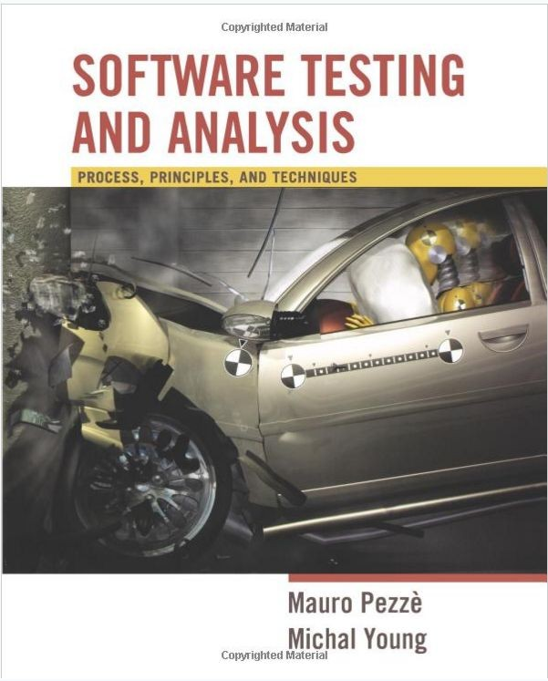
Textbook
Required:
Software Testing and Analysis, Mauro Pezze and Michal Young.
(Only one edition)
Reference books:
Software Testing: A Craftsman’s Approach, Fourth Edition - Paul C. Jorgensen.
The Art of Software Testing, 3rd Edition - Glenford J. Myers.

Slide 12


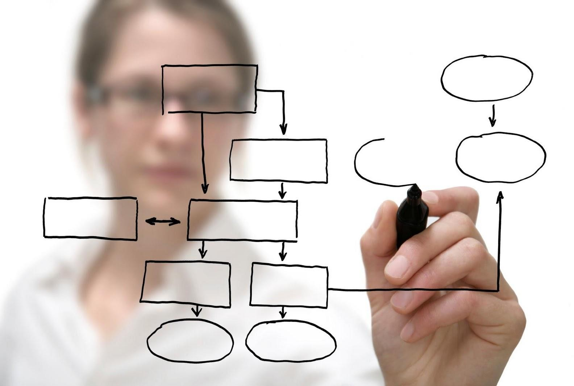
Learning Modes
Lectures/Textbook
Exercise sessions
CT/Project

Slide 13
Prerequisites
Familiarity with SDLC
Not essential, but very helpful to grasp basic concepts.
You need to be proficient in Java
Some knowledge of C++ might be required.
You should be able to read and write programs without additional instruction.
This is not a programming language class.
You need a basic understanding of algorithms, logic, and sets.

Slide 14
Assignments and Grading
Class tests & Assignments/Literature review (25% in total)
2-4 class tests (avg. of best (n-1)).
Take home assignments.
Project (30%).
Final Exam (40%).
Attendance(5%).
Participation (Bonus up to 5%)
In-class activities.
Group participation.
Answering questions.

Slide 15
Some Tips
This class can be time consuming.
Understanding the material takes time.
You are the explores in an uncharted land.
Documentation and organization.
Do not underestimate the workload.
A task left for tomorrow is a task left undone.
Planning and scheduling your time is essential.
Don’t be afraid to ask questions.

Slide 16
Feedback
Problems with assignments, course questions, feedback?
Contact me! Even if anonymously! I appreciate feedback.
Problem with instructor
Also contact me

Slide 17
Other Policies
Integrity and Ethics:
The homework and programs you submit for this class must be entirely your own. If this policy is not absolutely clear, then please contact me. Any other collaboration of any type on any assignment is not permitted. It is your responsibility to protect your work from unauthorized access.
Classroom Climate:
All students are expected to behave as scholars. This includes arriving on time, not talking during lecture (unless addressing the instructor), and not leaving the classroom before the end of lecture. Disruptive students will be warned and potentially dismissed from the classroom.

Slide 18
Other Policies
Make-Up and Late Submission
Make-ups for graded activities may be arranged if your absence is caused by a documented illness or personal emergency.
Homework assignments are due at the time noted on the assignment handout. Late work is not accepted without prior approval. Any assignment turned in after the due date will be considered late and will be subject to a penalty 25% per day, 0% after two days, including weekends and holidays.

Slide 19
When is software ready for release?

Slide 20
The short (and not so simple) answers...
We release when we can’t find any bugs…
We release when we have finished testing…
We release when quality is high...

Slide 21
Software Quality
We all want high-quality software.
We don’t all agree on the definition of quality.
Quality encompasses both what the system does and how it does it.
How quickly it runs.
How secure it is.
How available its services are.
How easily it scales to more users.
Quality is hard to measure and assess objectively.

Slide 22
Quality Attributes
Describe desired properties of the system.
Developers prioritize attributes and design system that meets chosen thresholds.
Most relevant for this course: dependability
Ability to consistently offer correct functionality, even under unforeseen or unsafe conditions.

Slide 23
Quality Attributes
Availability
Ability to carry out a task when needed, to minimize “downtime”, and to recover from failures.
Modifiability
Ability to enhance software by fixing issues, adding features, and adapting to new environments.
Testability
Ability to easily identify faults in a system.
Probability that a fault will result in a visible failure.

Slide 24
Quality Attributes
Performance
Ability to meet timing requirements. When events occur, the system must respond quickly.
Security
Ability to protect information from unauthorized access while providing service to authorized users.
Scalability
Ability to “grow” the system to process more concurrent requests.

Slide 25
Quality Attributes
Interoperability
Ability to exchange information with and provide functionality to other systems.
Usability
Ability to enable users to perform tasks and provide support to users.
How easy it is to use the system, learn features, adapt to
meet user needs, and increase confidence and satisfaction in usage.

Slide 26
Quality Attributes
Resilience
Supportability
Portability
Development Efficiency
Time to Deliver
Tool Support
Geographic Distribution

Slide 27
When is Software Ready for Release?
Software is ready for release when you can argue that it is dependable.
Correct, reliable, safe, and robust.
The primary process of making software dependable (and providing evidence of dependability) is Verification and Validation.

Slide 28
Verification and Validation
Activities that must be performed to consider the software “done.”
Verification: The process of proving that the software conforms to its specified functional and non-functional requirements.
Validation: The process of proving that the software meets the customer’s true requirements, needs, and expectations.

Slide 29
Verification and Validation
Barry Boehm, inventor of the term “software engineering”, describes them as:
Verification:
“Are we building the product right?”
Validation:
“Are we building the right product?”

Slide 30
Verification
Is the implementation consistent with its specification?
“Specification” and “implementation” are roles.
Source code and requirement specification.
Detailed design and high-level architecture.
Test oracle and requirement specification.
Verification is an experiment.
Does the software work under conditions we set?
We can perform trials, evaluate the software, and provide evidence for verification.

Slide 31
Verification
Is a implementation consistent with a specification?
“Specification” and “implementation” are roles.
Usually source code and requirement specification.
But also…
Detailed design and high-level architecture.
Design and requirements.
Test cases and requirements.
Source code and user manuals.

Slide 32
Software Testing
Test Input
An investigation into system quality.
Based on sequences of stimuli and
observations.
SUT
Output
Stimuli that the system must react to.
Observations of system reactions.
Verdicts on correctness.
Test Oracle (Expected Output)
Verdict (Pass/Fail)
32

Slide 33
Validation
Does the product work in the real world?
Does the software fulfill the users’ actual needs?
Not the same as conforming to a specification.
If we specify two buttons and implement all behaviors related to those buttons, we can achieve verification.
If the user expected a third button, we have not achieved validation.

Slide 34
Verification and Validation
Verification
Does the software work as intended?
Validation
Does the software meet the needs of your users?
Shows the software is useful.
This is much harder.
Validation shows that software is useful. Verification shows that it is dependable. Both are needed to be ready for release.

Slide 35
Verification and Validation: Motivation
Both are important.
A well-verified system might not meet the user’s needs.
A system can’t meet the user’s needs unless it is well-constructed.
This course largely focuses on
verification.
How can we ensure that the software we build is dependable.
Testing is the primary activity of verification, and our main focus in this class.

Slide 36
Required Level of V&V
The goal of V&V is to establish confidence that the system is “fit for purpose.”
How confident do you need to be? Depends on:
Software Purpose: The more critical the software, the more important that it is reliable.
User Expectations: When a new system is installed, how willing are users to tolerate bugs because benefits outweigh cost of failure recovery.
Marketing Environment: Must take into account competing products - features and cost - and speed to market.

Slide 37
Basic Questions
When do verification and validation start? When are they complete?
What techniques should be applied to obtain acceptable quality at an acceptable cost?
How can we assess readiness for release?
How can we control the quality of successive releases?
How can the development process be improved to make verification more effective (in cost and impact)?

Slide 38
When Does V&V Start?
V&V can start as soon as the project starts.
Feasibility studies must consider quality assessment.
Requirements can be used to derive test cases.
Design can be verified against requirements.
Code can be verified against design and requirements.
Feedback can be sought from stakeholders at any time.

Slide 39

Types of Verification
Static Verification
Analysis of static system artifacts to discover problems.
Proofs: Posing hypotheses and
making a logical argument for their
validity using specifications, system
models, etc.
Inspections: Manual “sanity check”
on artifacts (such as source code) by other people or tools, searching for issues.

Slide 40
Advantages of Static Verification
During execution, errors can hide other errors. It can be hard to find all problems or trace back to a single source. Static inspections are not impacted by program interactions.
Incomplete systems can be inspected without
additional costs. If a program is incomplete, special code is needed to run the part that is to be tested.
Inspection can also assess quality attributes such
as maintainability, portability, poor programming, inefficiencies, etc.

Slide 41
Dynamic Verification
Exercising and observing the system to argue that it meets the requirements.
Testing: Formulating controlled sets of input to demonstrate requirement satisfaction or find faults.
Fuzzing: Spamming the system with random input to locate security vulnerabilities, memory leaks, buffer overruns, etc.
Taint Analysis: Assigning a bad value to a variable and monitoring which system variables it corrupts and how it corrupts them.

Slide 42
Dynamic Verification
Static verification is not good at discovering problems that arise from runtime interaction, timing problems, or performance issues.
Dynamic verification is often cheaper than static - easier to automate.
However, it cannot prove that properties are met - cannot try all possible executions.

Slide 43
How Can We Assess the Readiness of a Product?
Identifying faults is useful, but finding all faults is nearly impossible.
Instead, need to decide when to stop verification and validation.
Need to establish criteria for acceptance.
How good is “good enough”?
One option is to measure dependability (availability, mean time between failures, etc) and set a “acceptability threshold”.

Slide 44
Product Readiness
Another option is to put it in the hands of human users.
Alpha/Beta Testing - invite a small group of users to start using the product, have them report feedback and faults. Use this to judge product readiness.
Can make use of dependability metrics for a quantitative judgement (metric > threshold).
Can make use of surveys as a qualitative judgement (are the users happy with the current product?)

Slide 45
Ensuring the Quality of Successive Releases
Verification and validation do not end with the release of the software.
Software evolves - new features, environmental adaptations, bug fixes.
Need to test code, retest old code, track changes.
Faults have not always been fixed before release. Do not forget those.
Regression Testing - when code changes, rerun tests to ensure that it still works.
As faults are repaired, add tests that exposed them to the suite.

